Slide 1
Big Data Frameworks
CSE3120
Dr. Sudharson S
Asst. Professor Sr
SCOPE

Slide 2
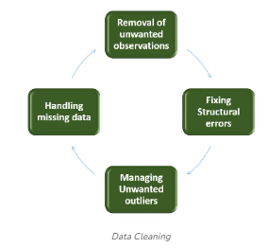
Data Cleaning
Data cleaning is a crucial step, as it involves identifying and removing any missing, duplicate, or irrelevant data. The goal of data cleaning is to ensure that the data is accurate, consistent, and free of errors.
The incomplete, and inconsistent data, can negatively impact the accuracy and reliability of the system.

Slide 3
Data Cleaning
The code reads data from a CSV file, cleans it (fixes issues like duplicates, missing data, and invalid values), and saves the cleaned data into a new CSV file.
Key Steps:
1. Input and Output Setup
2. Reading Data
3.Cleaning Data --- Remove Whitespaces, Skip Missing Data, Remove Duplicates, Handle Invalid Data: if column contains non-numeric data, it is replaced with "N/A“
4. Writing Cleaned Data
5. Finishing Up

Slide 4
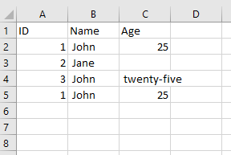
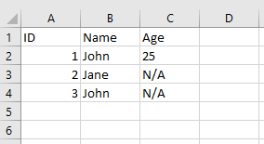
Data Cleaning

